Slide 1
Jenkins Training – Day 2 23-09-2022
DevSecops Team

Slide 2
AGENDA
Introduction.
What is Devops and Its Lifecycle.
Key Components of Devops Lifecycle and Its Benefits.
What is Jenkins, History & Benefits of Jenkins.
Jenkins Installation
5.1 Jenkins Installation on Windows.
5.2 Jenkins Installation on Ubuntu.
Jenkins Dashboard and its various options overview.
Types of jobs in Jenkins
7.1 Free Style jobs.
7.2 Declarative Pipelines Jobs.
Jenkins master-slave distributed build concepts.
Security Matrix options in Jenkins.
Email-Notification configurations for pipelines.

Slide 3
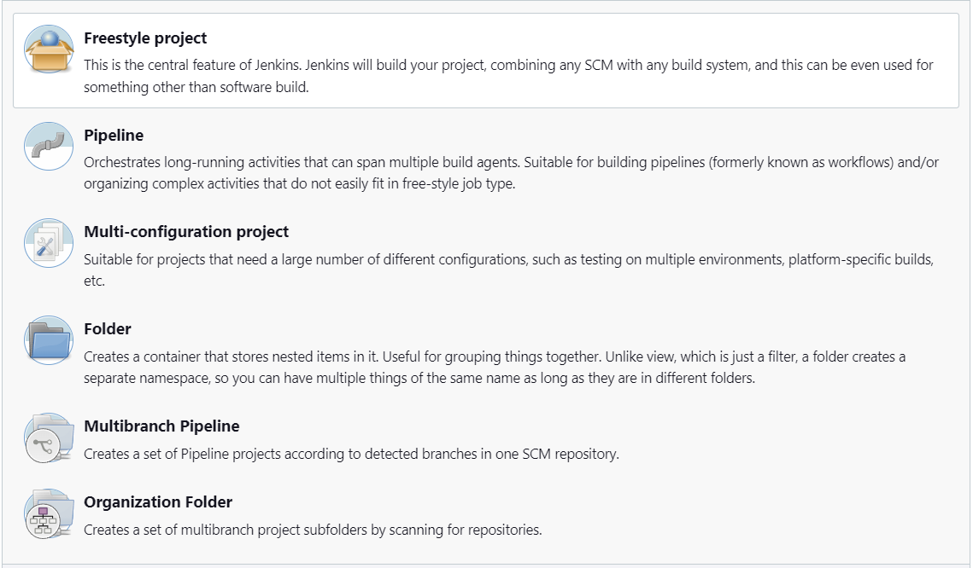
7. Types of jobs in Jenkins
What Is Jenkins Job?
In simple words, any automated process that is implemented in Jenkins is a Jenkins Job.
The automated process can be about building the source code. The source code can be merged from any of the source code management like git, SVN, and perforce.
Different Types of Jenkins Job?

Slide 4
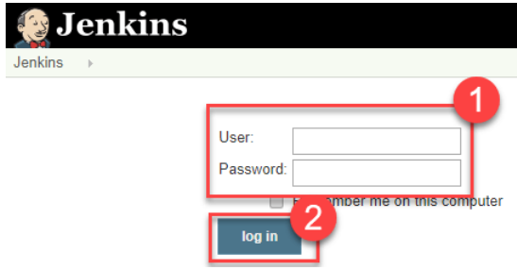
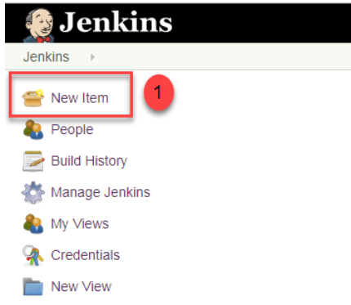
7.1 Free Style jobs.
Free style job in Jenkins?
The freestyle build job is a highly flexible and easy-to-use option. You can use it for any type of project; it is easy to set up, and many of its options appear in other build jobs. Below is a step by step process to create job in Jenkins.
Step 1. Login to Jenkins Step 2. Create New Item
Click on “New Item” at the top left-hand side of your dashboard. dashboard.

Slide 5
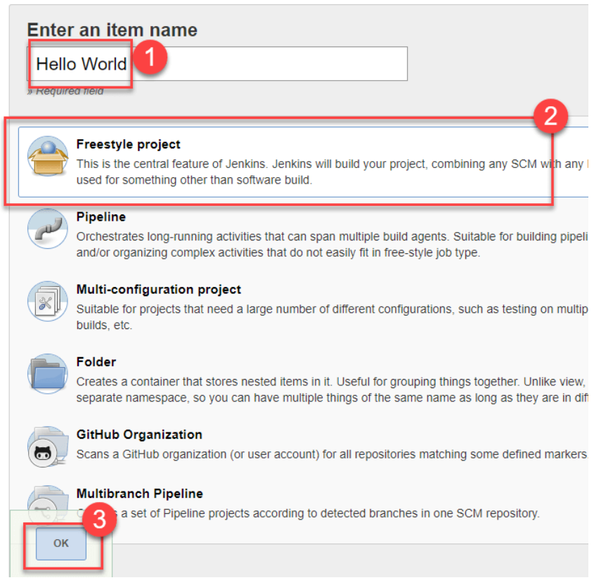
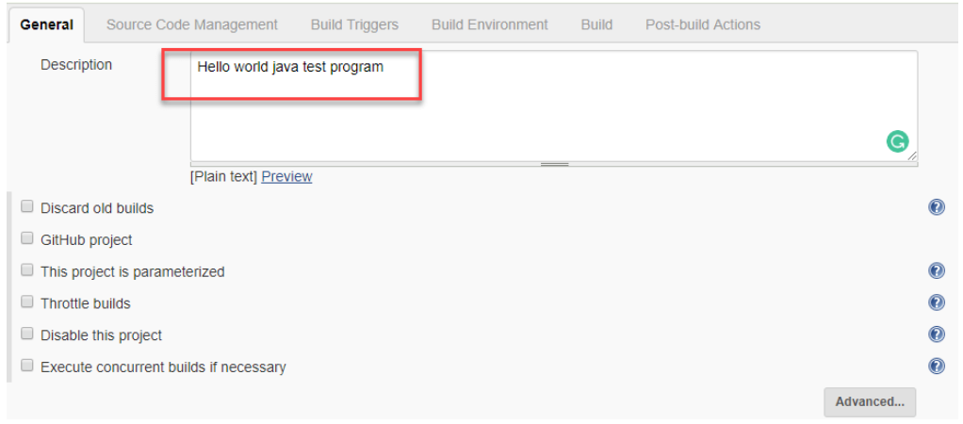
7.1 Free Style jobs.
Step 3. Enter Item details Step 4. Enter Project details Enter the details of the project you want to test..
Enter the name of the item you want to create.
We shall use the “Hello world” for this demo.
2. Select Freestyle project
3. Click Okay

Slide 6
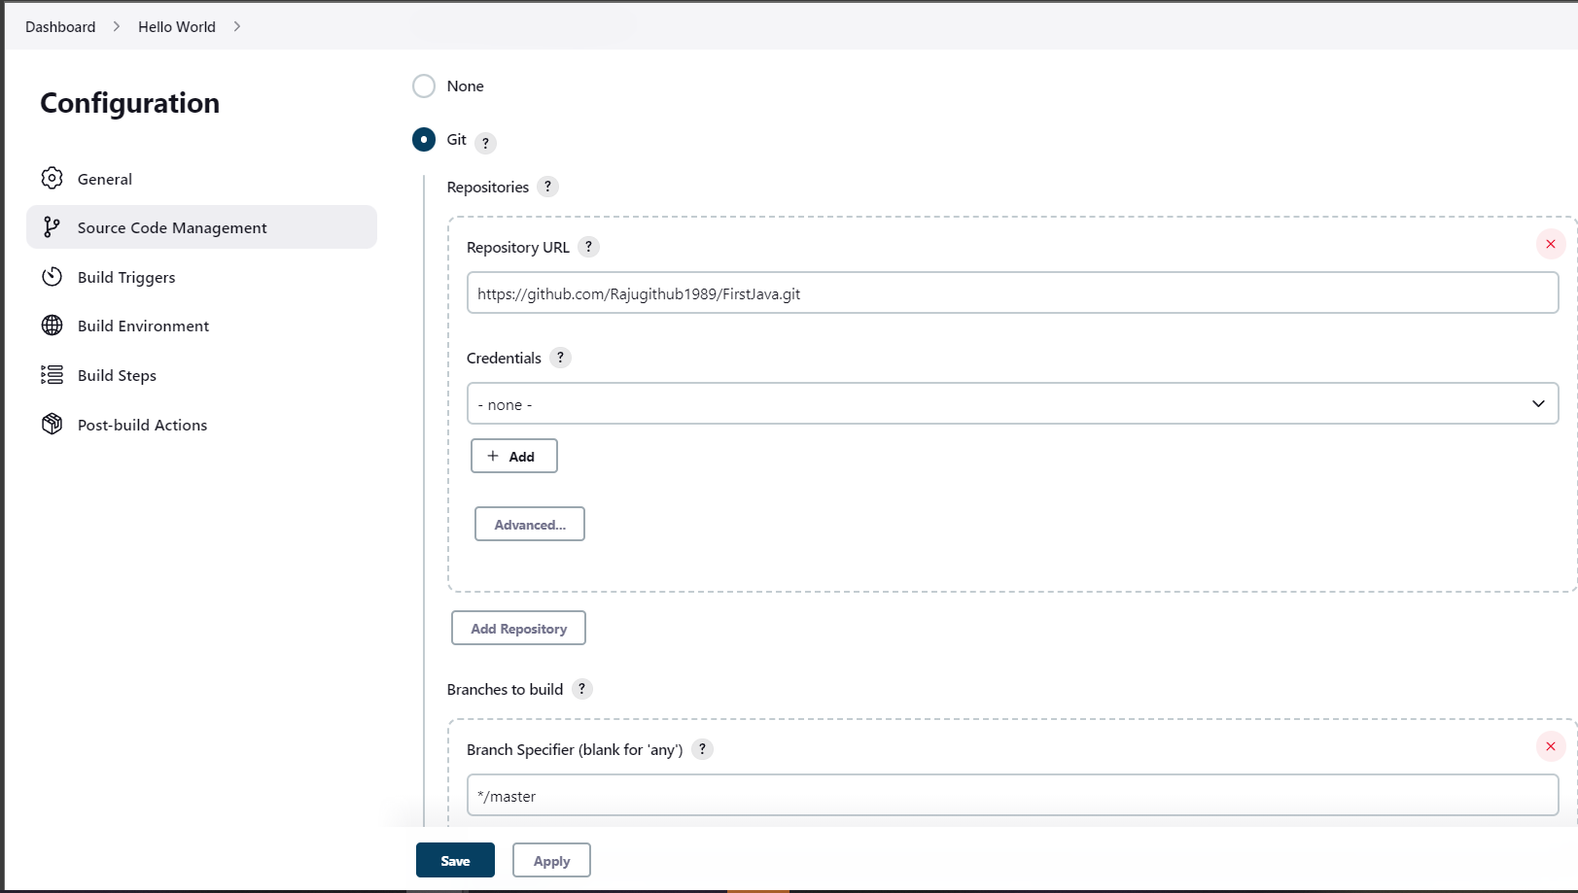
7.1 Free Style jobs.
Step 5. Enter repository URL
Under Source Code Management, Enter your repository URL. We have a test repository located at
https://github.com/Rajugithub1989/FirstJava.git
It is also possible for you to use a local repository.
If your GitHub repository is private, Jenkins will first validate your login credentials with GitHub and only then pull the source code from your GitHub repository.

Slide 7
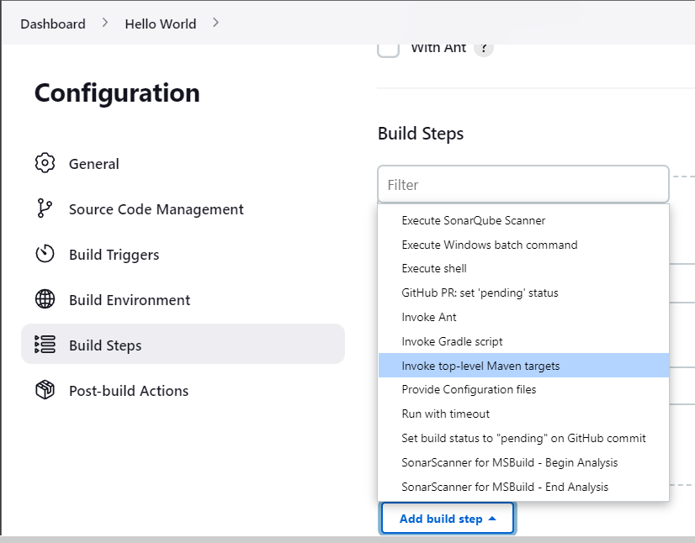
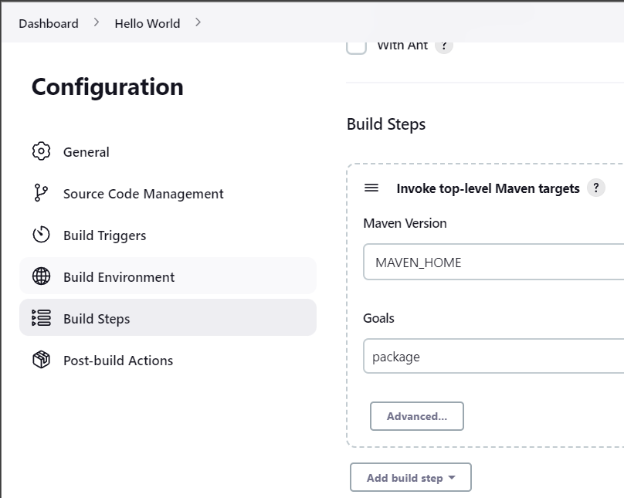
7.1 Free Style jobs.
Step 6. Tweak the settings
Now that you have provided all the details, it’s time to build the code. Tweak the settings under the build section to build the code at the time you want. You can even schedule the build to happen periodically, at set times.
Under build,
1. Click on “Add build step”
2. Click on “Invoke top level Maven targets” and add the commands you want to execute during the build process.

Slide 8
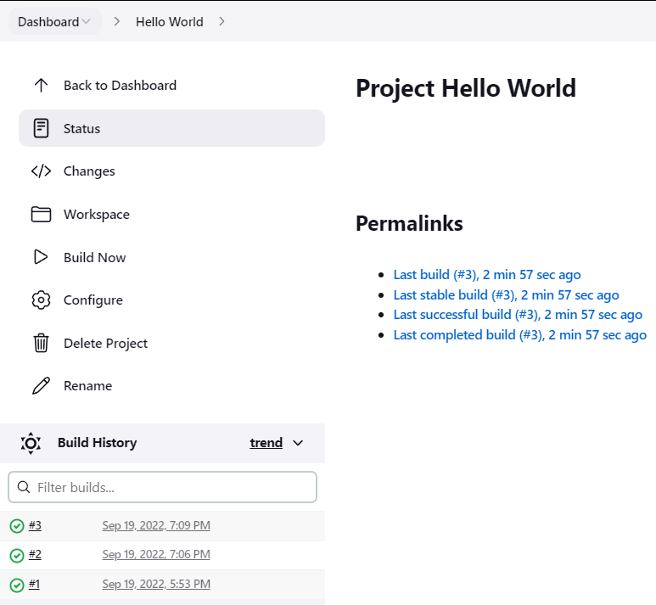
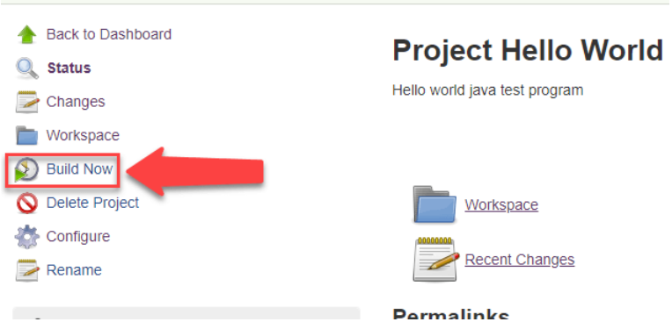
7.1 Free Style jobs.
Step 7. Save the project Step 9. Check the status
When you have entered all the data, After clicking on Build now, you can see the status of the build you run under Build History.
Click Apply
Save the project.
Step 8. Build Source code
Now, in the main screen, Click the Build Now button on the left-hand side to build the source code.

Slide 9
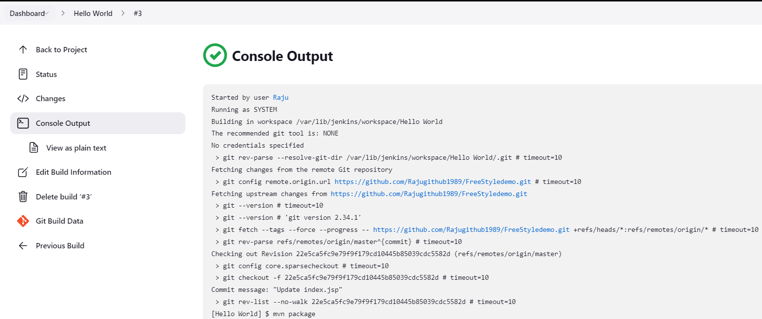
7.1 Free Style jobs.
Step 10. See the console output
Click on the build number and then Click on console output to see the status of the build you run. It should show you a success message, provided you have followed the setup properly as shown in the below Jenkins create new job example.

Slide 10
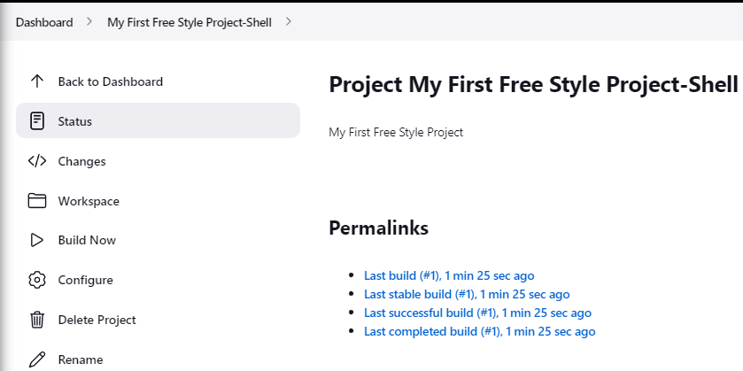
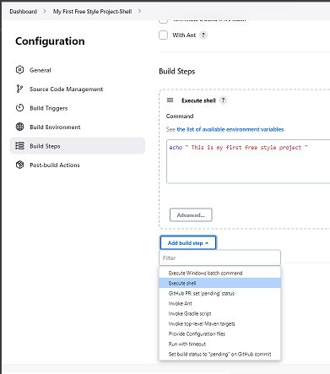
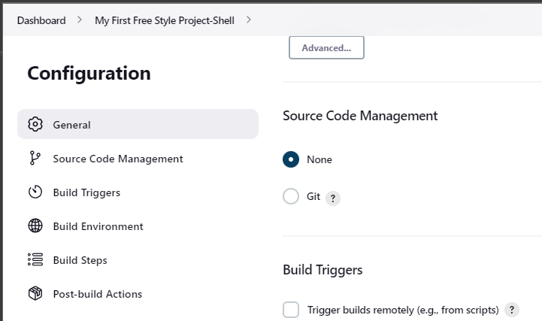
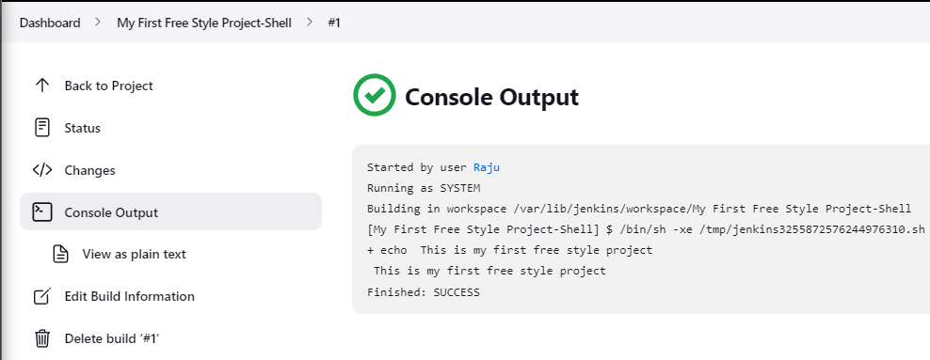
7.1 Free Style jobs - shell
1
4
3
2
5

Slide 11
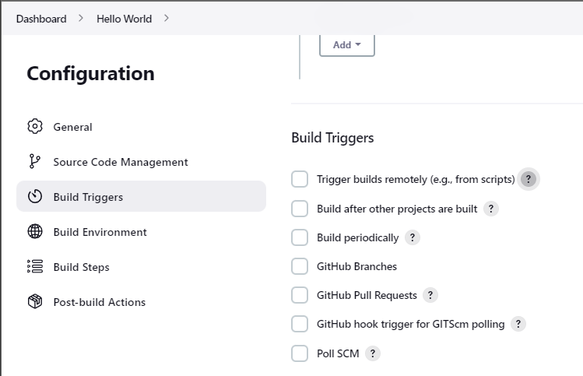
7.1 Free Style jobs – Build triggers
What is a trigger?
A trigger lets us execute a job on an event occurrence. This event is called a trigger. To see the list of build triggers, we need to login to Jenkins and click on any item already created and click on configure.
The list of triggers is shown in Figure
Trigger build remotely: The job is usually triggered by accessing a specified URL. This is convenient for scripts. With the URL, one needs to mention the authorization token as well.
Build after other projects are built: As it reads, we need to mention the list of other projects, once those projects are built then the present job is executed.
Build periodically: The build is triggered based on the mentioned time. A cron has to be mentioned here.
Github hook trigger for GITSCM polling: If Jenkins receives push GitHub hook from a repository associated with git, then the build process gets executed.
Poll SCM: Configure Jenkins to poll the SCM for pushes or commits and then trigger the jobs.

Slide 12
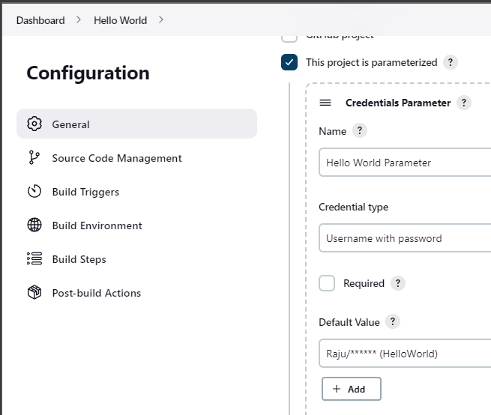
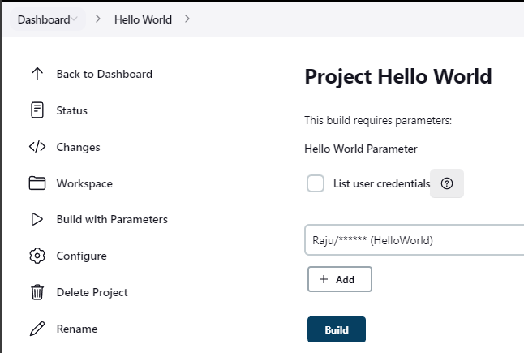
7.1 Free Style jobs – Build triggers
This project is parameterized
Using build parameters, we can pass any data we want: git branch name, secret credentials, hostnames and ports, and so on. Any Jenkins job or pipeline can be parameterized. All we need to do is check the box on the General settings tab, “This project is parameterized”: Then we click the Add Parameter button.
1
2

Slide 13
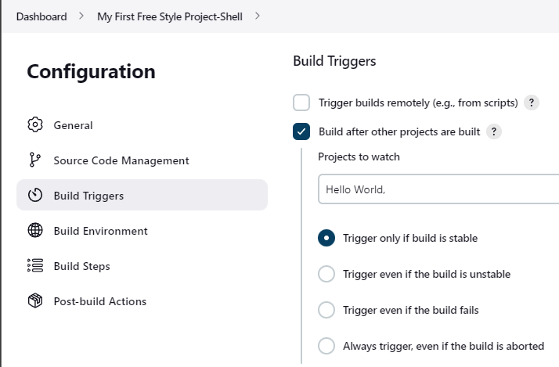
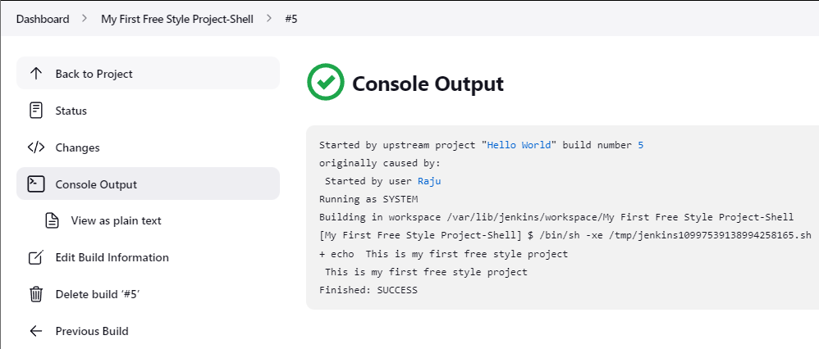
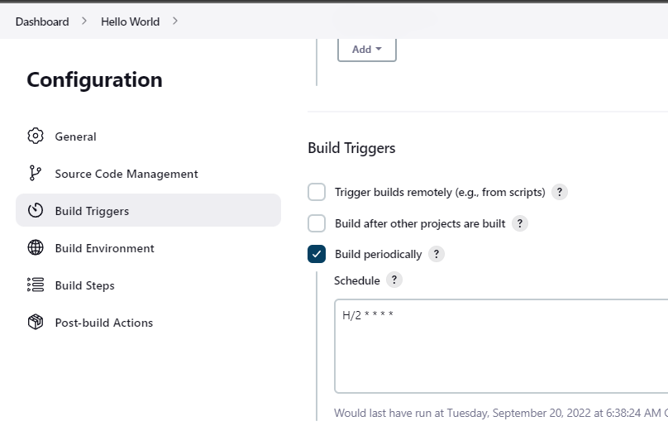
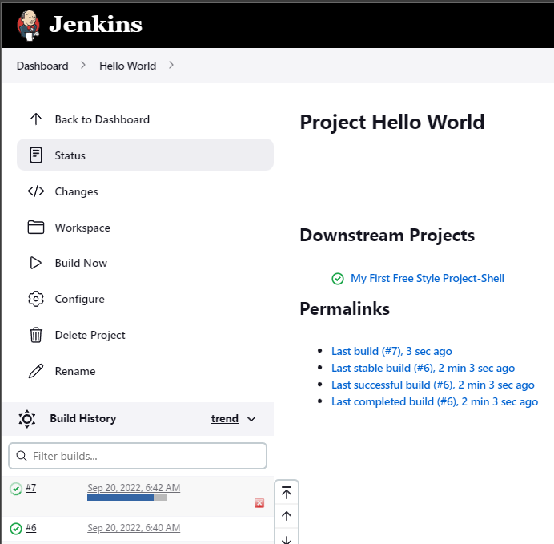
7.1 Free Style jobs – Build triggers
Build after other projects are built
A downstream job is a configured project that is triggered as part of a execution of pipeline. Upstream and downstream jobs help you to configure the sequence of execution for different operations and hence you can orchestrate the flow of execution. We can configure one or more projects as downstream jobs in Jenkins.
Build Periodically
Under Build Triggers - Build periodically - Schedule you can create a schedule (or multiple schedules) for Jenkins to build periodically or on a specific date/time. It might be tests that should be run periodically (every morning for example) or a DB clean up Jenkins job or any other Jenkins job.
1
2
1
2

Slide 14
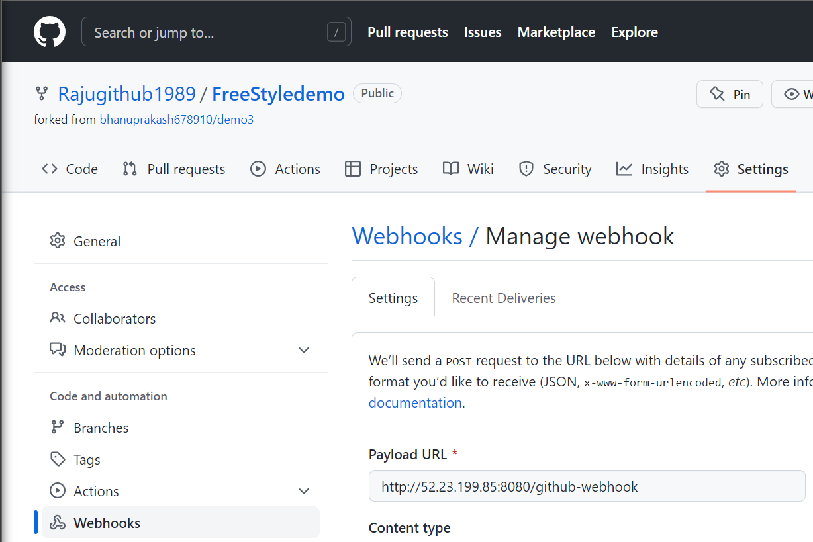
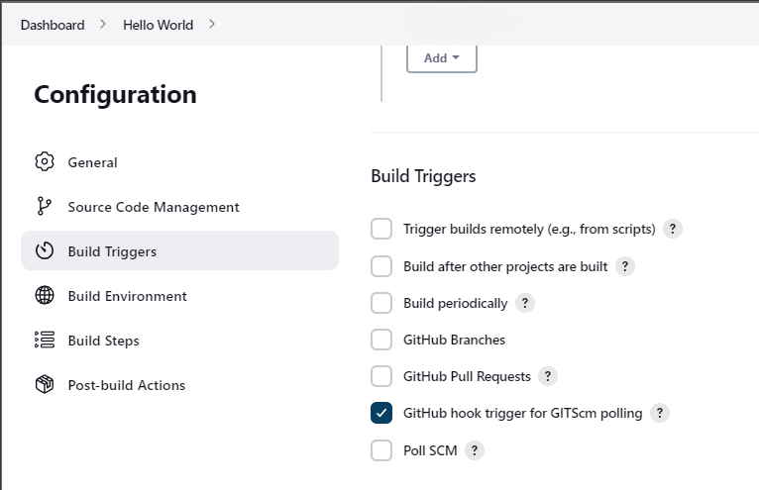
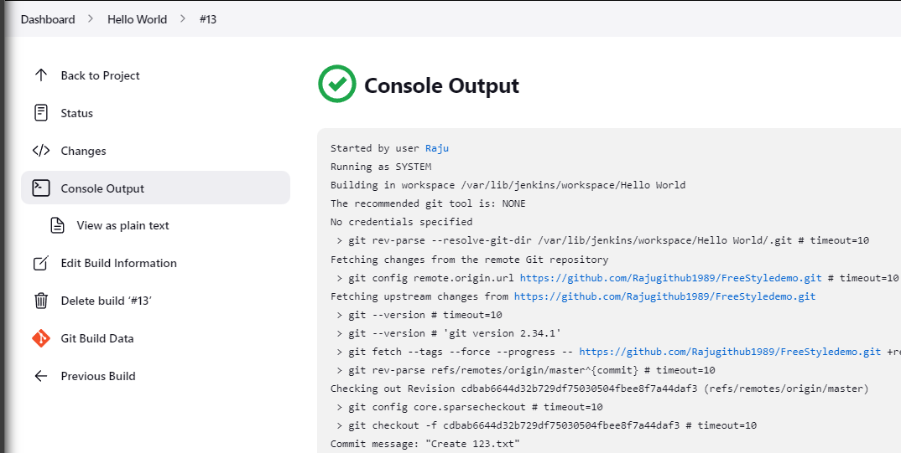
7.1 Free Style jobs – Build triggers
The Github Integration plugin will add the “Github hook trigger for GITScm polling” option for you. Which means that every time Jenkins receives a PUSH GitHub hook (from the repository you defined in the Source Code Management section) it will trigger the polling login you previously defined.
1
3
2
1
A webhook can be thought of as a type of API that is driven by events rather than requests. Instead of one application making a request to another to receive a response, a webhook is a service that allows one program to send data to another as soon as a particular event takes place.
2

Slide 15
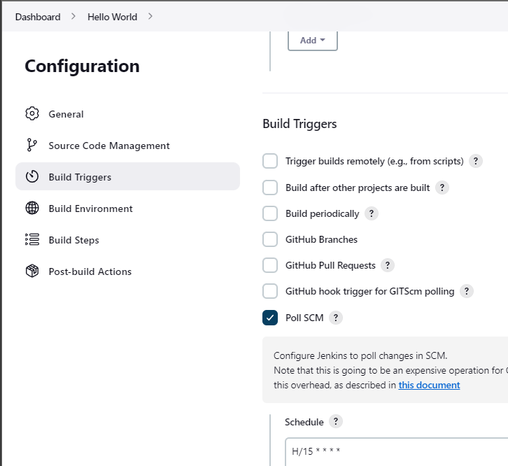
7.1 Free Style jobs – Build triggers
What is the poll SCM?
"Poll SCM" polls the SCM periodically for checking if any changes/ new commits were made and shall build the project if any new commits were pushed since the last build, whereas the "build" shall build the project periodically irrespective to whether or not any changes were made.

Slide 16
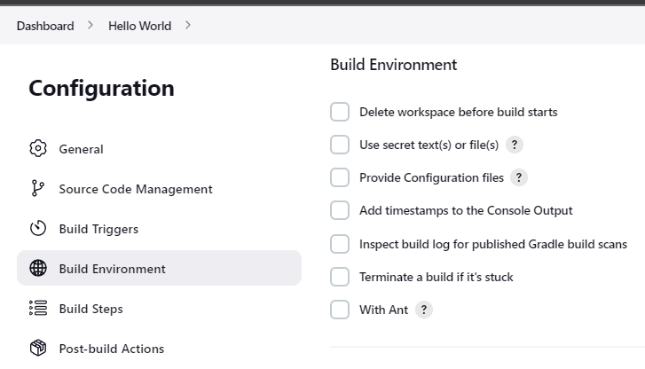
7.1 Free Style jobs – Build Environment
Delete workspace before build starts
There is a way to clean up a workspace in Jenkins. You need to install the Workspace Cleanup Plugin. This plugin can clean up the workspace before build or after a build. Under Build Environment, check the box that says Delete workspace before build starts.
Use secret text(s) or file(s)
Allows you to take credentials of various sorts and use them from shell build steps
Provide Configuration files
Make globally configured files available in your local workspace. All files configured via the config-file-provider plugin are available and can be referenced.
Add timestamps to the Console Output
After installing the Timestamper Plugin, you have to configure each job by manually checking the "Add timestamps to the Console Output" option.
Terminate a build if it's stuck

Slide 17
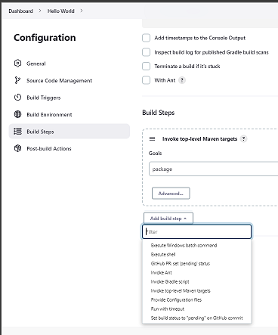
7.1 Free Style jobs – Build Steps
Build Steps Options
Options | Description
Execute Windows batch command | This option runs a windows batch script for building the project. The script runs with the workspace as the current directory.
Execute shell | This option runs a shell script for building the project. The script runs with the workspace as the current directory.
Invoke Ant | This option specifies a list of Ant targets to be invoked (separated by spaces ), or leave it empty to invoke the default Ant target specified in the build script.
Invoke Gradle Script | This option is for those projects that use Gradle as the build system. Here, Jenkins invokes Gradle with the given switches and tasks.
Invoke top-level Maven targets | This is for those projects that use Maven as the build system. This leads Jenkins to invoke Maven with the given goals and options. Jenkins passes various environment variables to Maven, which you can access from Maven as "${env. VARIABLE NAME} ".
Run with timeout | If a build does not complete by the specified amount of time, then the build will be terminated automatically and marked as aborted. Default time would be at least 3minutes.

Slide 18
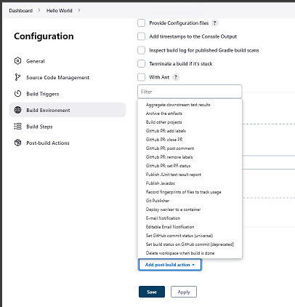
7.1 Free Style jobs – Post-build Actions
Post-build Actions
Options | Description
Archive the artifacts | Archives the build artifacts (for example, distribution zip files or jar files) so that they can be downloaded later.
Publish JUnit test result report | Jenkins understands the JUnit test report XML format (which is also used by TestNG). When this option is configured, Jenkins can provide useful information about test results, such as historical test result trends, a web UI for viewing test reports, tracking failures, and so on.
Deploy war/ear to a container | War/ear files to deploy. Relative to the workspace root. You can also specify like "**/*.war"
E-mail Notification | If configured, Jenkins will send out an e-mail to the specified recipients when a certain important event occurs.
Delete workspace when build is done | It deletes the workspace of particular pipeline after build is succeeded

Slide 19
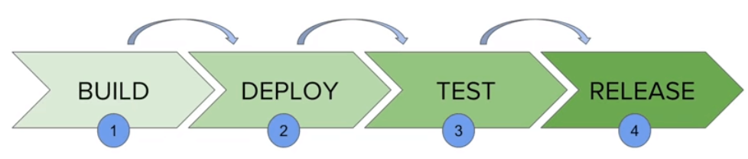
7.2 Declarative Pipelines Jobs.
What is Jenkins Pipeline?
Jenkins Pipeline is a combination of plugins that supports integration and implementation of continuous delivery pipelines. It has an extensible automation server to create simple and complex delivery pipelines as code via pipeline DSL. A Pipeline is a group of events interlinked with each other in a sequence.
What is Continuous Delivery Pipelines? How it Works?
In a Jenkins pipeline, every job or event has some sort of dependency on at least one or more events.
The picture above represents a continuous delivery pipeline in Jenkins. It contains a group of states called build, deploy, test and release. These events are interlinked with each other. Every state has its events, which work in a sequence called a continuous delivery pipeline.
A continuous delivery pipeline is an automated expression to display your process for getting software for version control. Thus, every change made in your software goes through a number of complex processes on its way to being released. It also involves developing the software in a reliable and repeatable manner, and progression of the built software through multiple stages of testing and deployment.

Slide 20
7.2 Declarative Pipelines Jobs.
What is a JenkinsFile?
Jenkins pipelines can be defined using a text file called JenkinsFile. You can implement pipeline as code using JenkinsFile, and this can be defined by using a domain specific language (DSL). With JenkinsFile, you can write the steps needed for running a Jenkins pipeline.
The benefits of using JenkinsFile are:
You can create pipelines automatically for all branches and execute pull requests with just one JenkinsFile.
You can review your Jenkins code on the pipeline
You can audit your Jenkins pipeline
This is the singular source for your pipeline and can be modified by multiple users.
JenkinsFile can be defined by either Web UI or with a Jenkins File.
There are two types of Jenkins pipeline syntax used for defining your JenkinsFile.
Declarative
Scripted
Declarative:
Declarative pipeline syntax offers an easy way to create pipelines. It contains a predefined hierarchy to create Jenkins pipelines. It gives you the ability to control all aspects of a pipeline execution in a simple, straight-forward manner.
Scripted:
Scripted Jenkins pipeline runs on the Jenkins master with the help of a lightweight executor. It uses very few resources to translate the pipeline into atomic commands. Both declarative and scripted syntax are different from each other and are defined totally differently.

Slide 21
7.2 Declarative Pipelines Jobs.
Why Use Jenkin’s Pipeline?
Jenkins is an open continuous integration server which has the ability to support the automation of software development processes. You can create multiple automation jobs with the help of use cases, and run them as a Jenkins pipeline.
Here are the reasons why you use should use Jenkins pipeline:
Jenkins pipeline is implemented as a code which allows multiple users to edit and execute the pipeline process.
Pipelines are robust. So if your server undergoes an unforeseen restart, the pipeline will be automatically resumed.
You can pause the pipeline process and make it wait to resume until there is an input from the user.
Jenkins Pipelines support big projects. You can run multiple jobs, and even use pipelines in a loop.
Jenkins Pipeline Concepts
Term | Description
Pipeline | The pipeline is a set of instructions given in the form of code for continuous delivery and consists of instructions needed for the entire build process. With pipeline, you can build, test, and deliver the application.
Node | The machine on which Jenkins runs is called a node. A node block is mainly used in scripted pipeline syntax.
Stage | A stage block contains a series of steps in a pipeline. That is, the build, test, and deploy processes all come together in a stage. Generally, a stage block is used to visualize the Jenkins pipeline process.
Step | A step is nothing but a single task that executes a specific process at a defined time. A pipeline involves a series of steps.

Slide 22
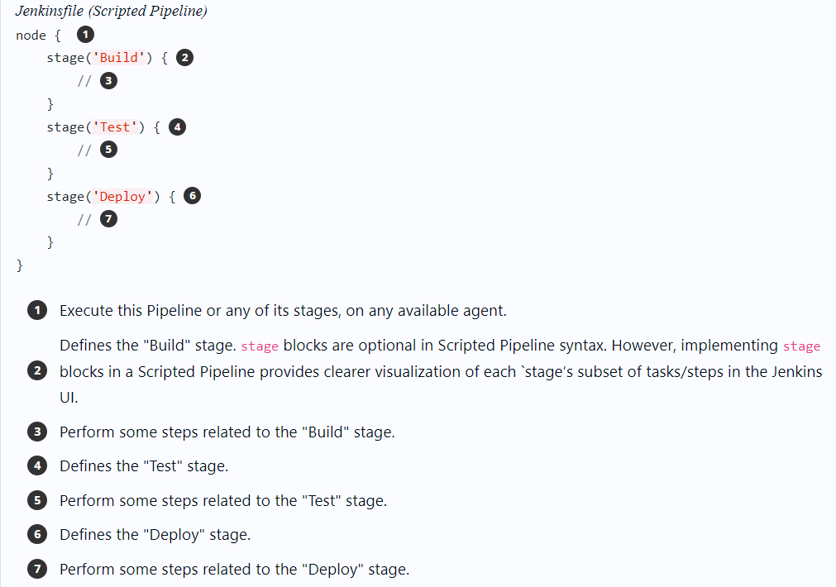
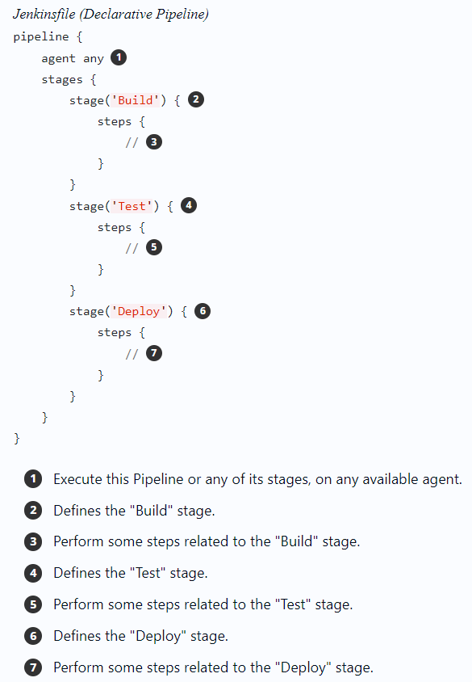
7.2 Declarative Pipelines Jobs.

Slide 23
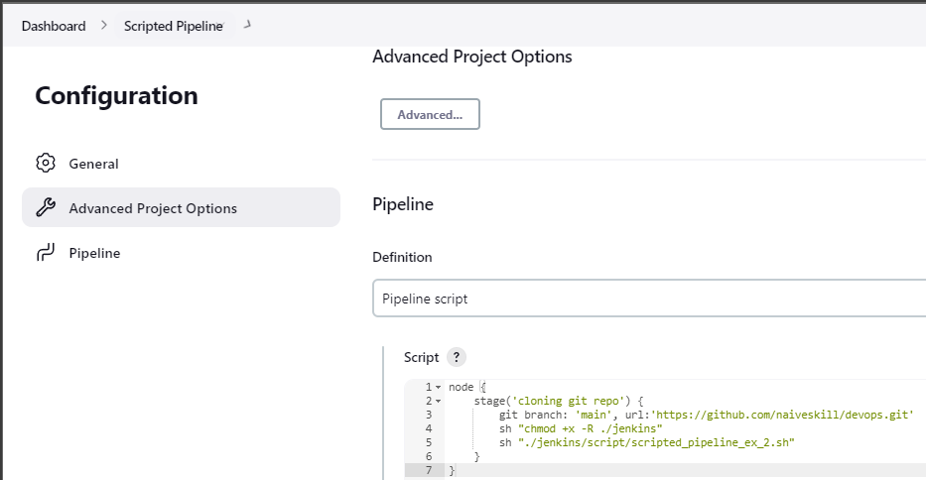
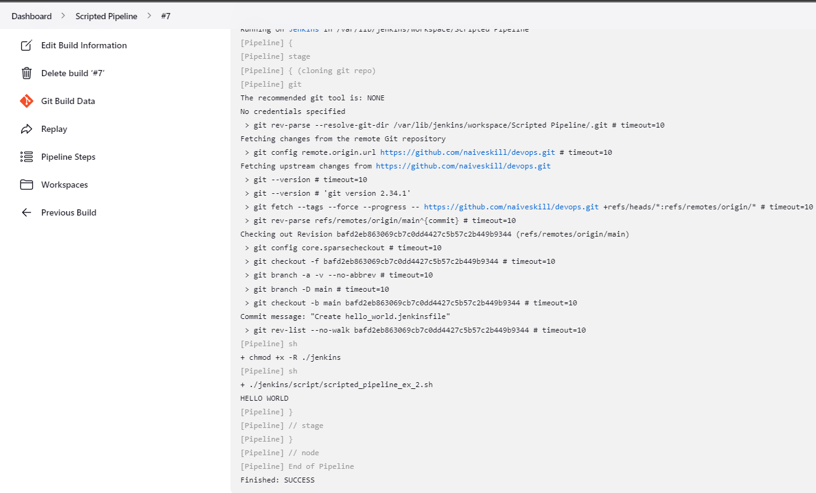
7.2 Declarative Pipelines Jobs.
Scripted Pipelines : Demo (Pipeline Scripts)

Slide 24
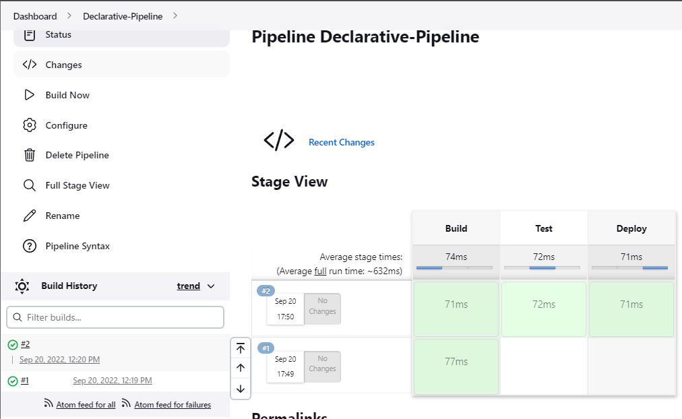
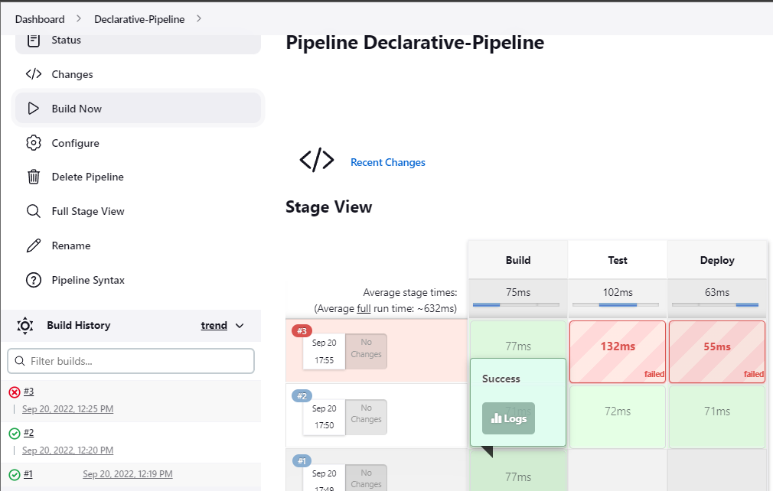
7.2 Declarative Pipelines Jobs.
Declarative Pipelines : Demo (Pipeline Scripts)
Using a Jenkinsfile

Slide 25
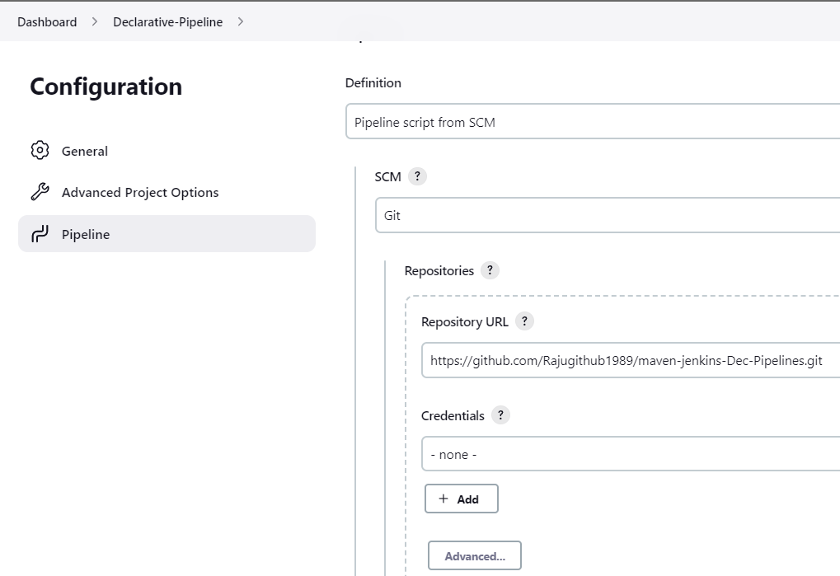
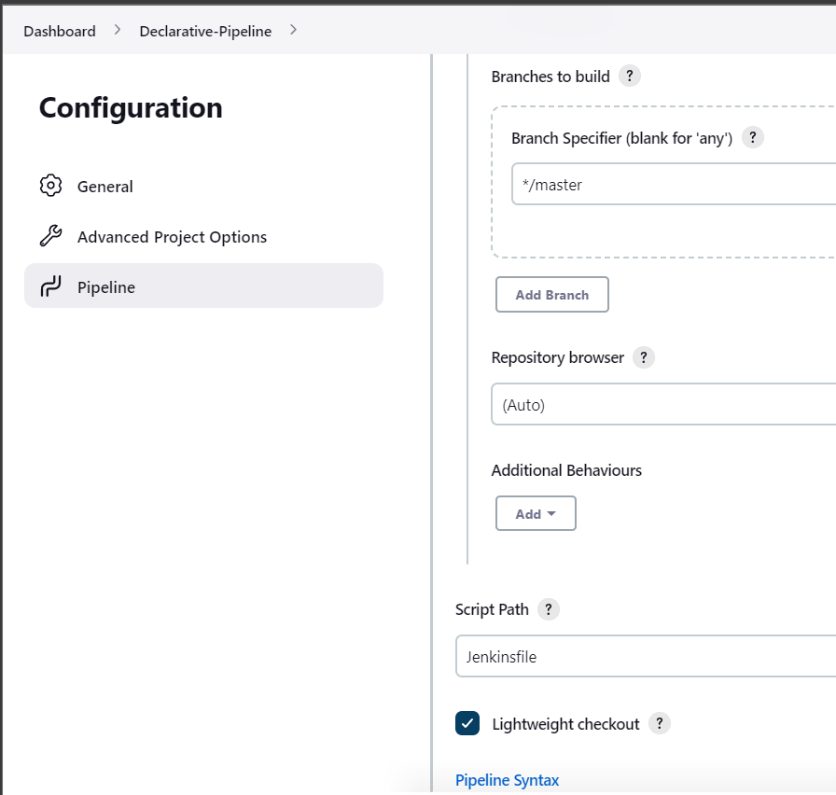
7.2 Declarative Pipelines Jobs.
Declarative Pipelines : Demo (Pipeline Script from SCM)
Check github repo for sample project (maven-jenkins-Dec-Pipelines )

Slide 26
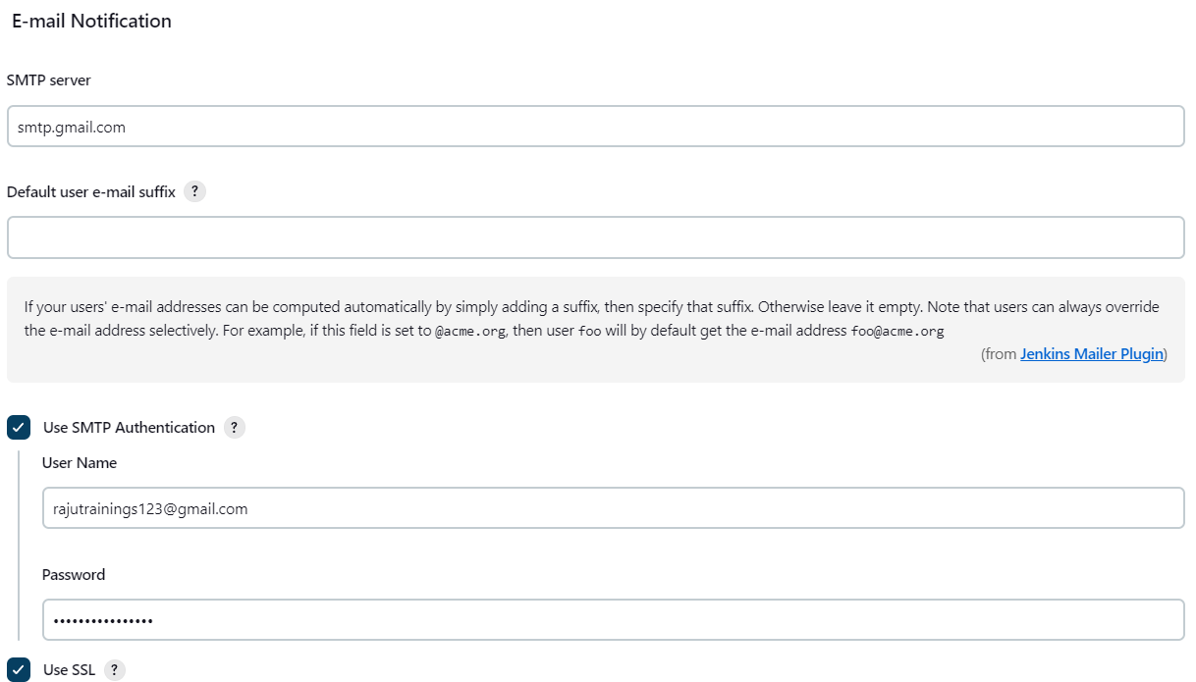
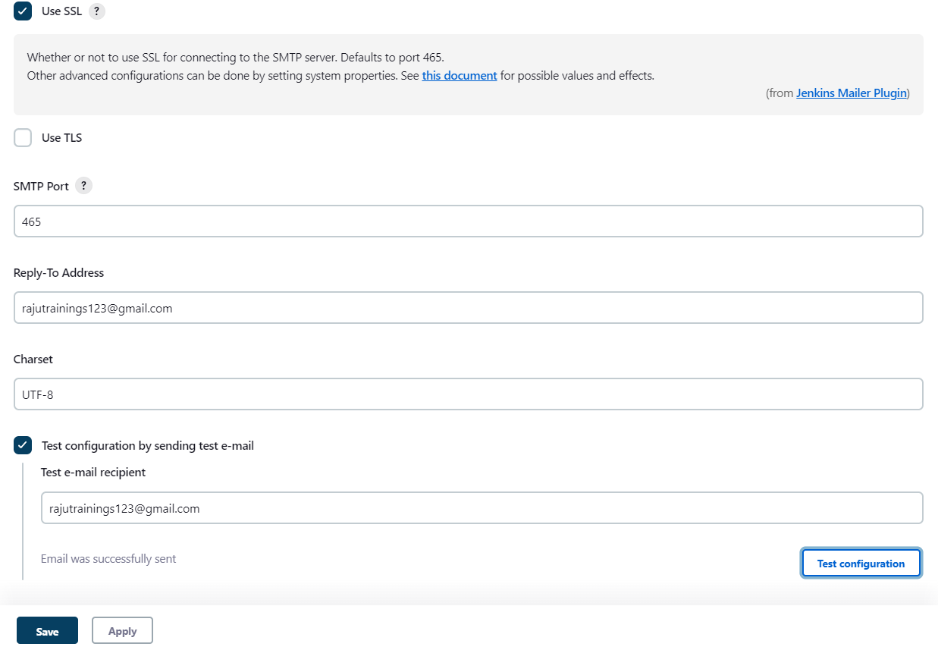
7.2 Declarative Pipelines Jobs.
Declarative Pipelines : Email Notification (Pipeline Scripts from SCM)

Slide 27
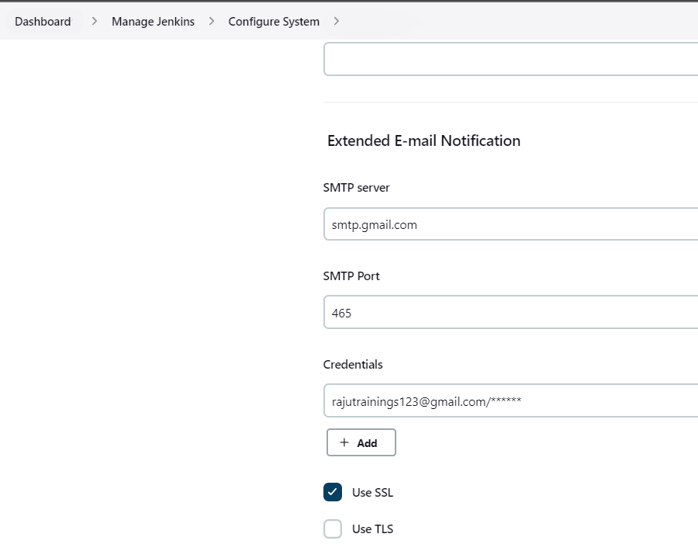
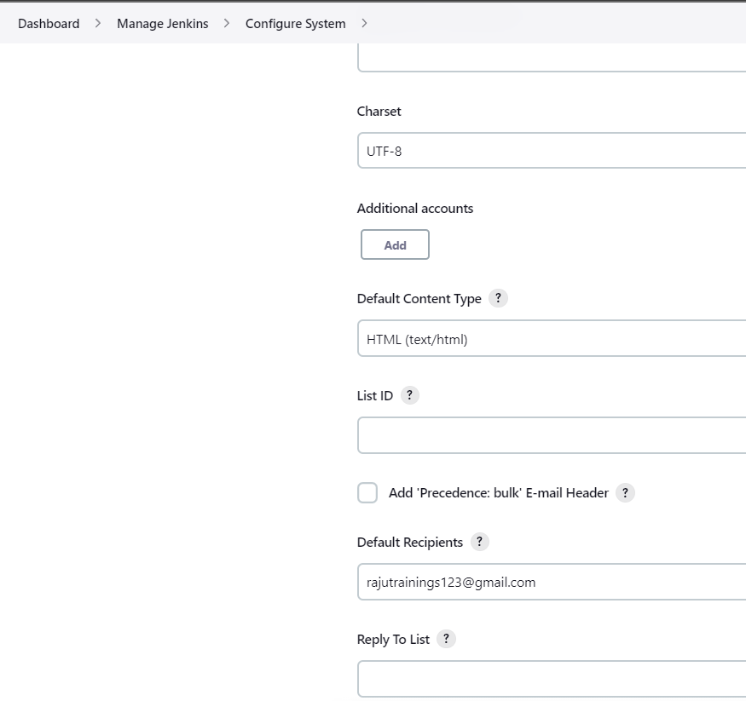
7.2 Declarative Pipelines Jobs.
Declarative Pipelines : Email Notification (Pipeline Scripts from SCM)

Slide 28
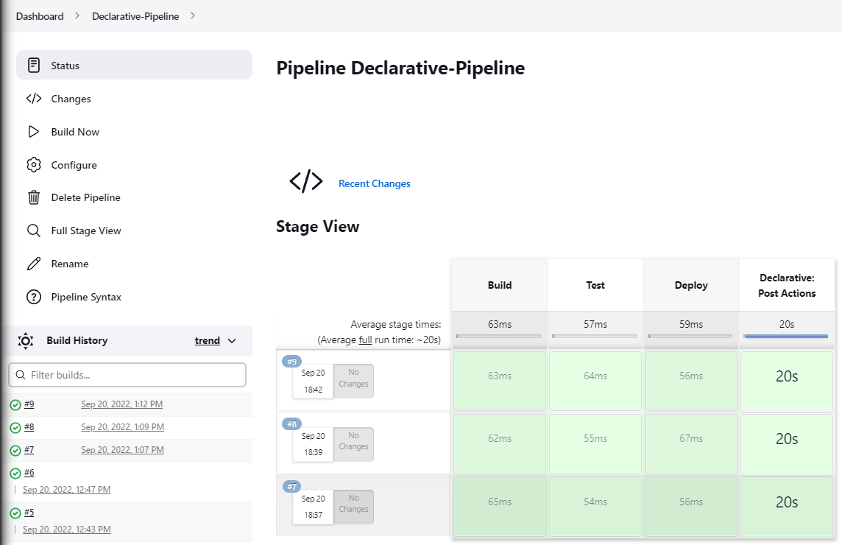
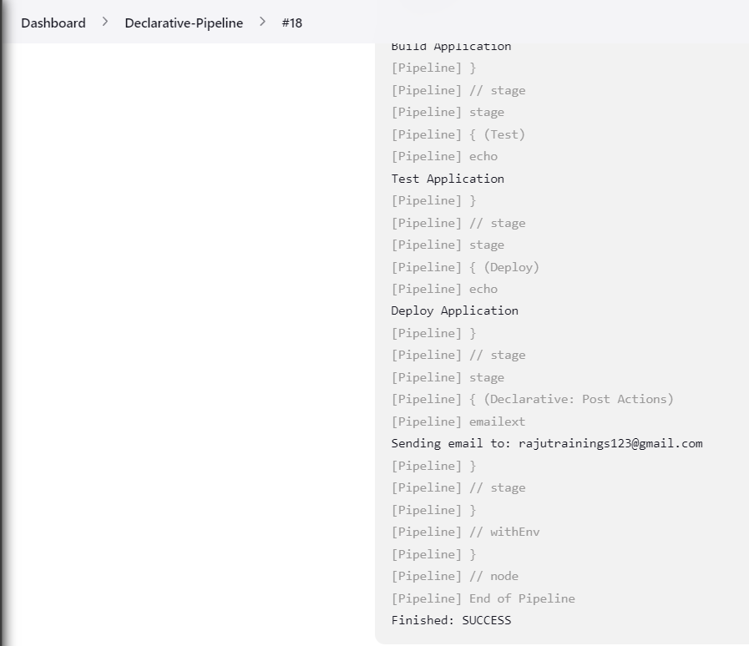
7.2 Declarative Pipelines Jobs.
Declarative Pipelines : Email Notification (Pipeline Scripts from SCM)

Slide 29
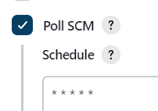
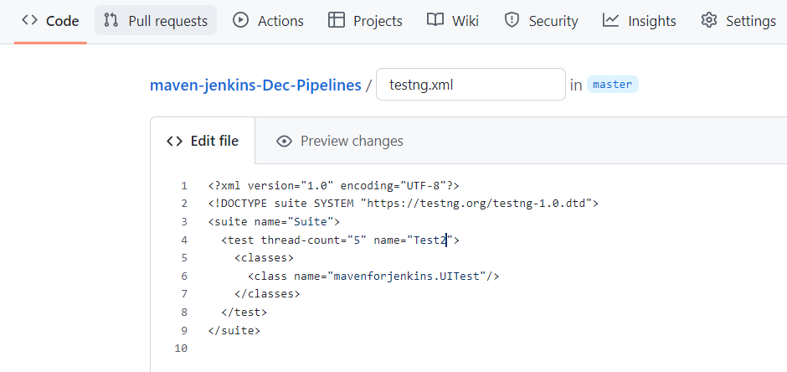
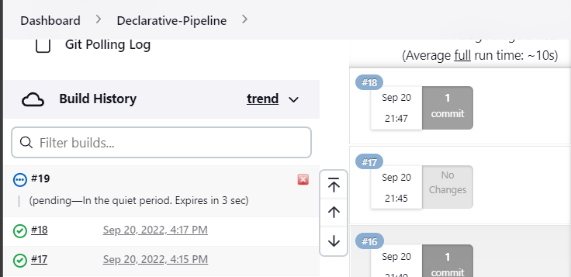
7.2 Declarative Pipelines Jobs.
Declarative Pipelines : Email Notification (Pipeline Scripts from SCM)

Slide 30
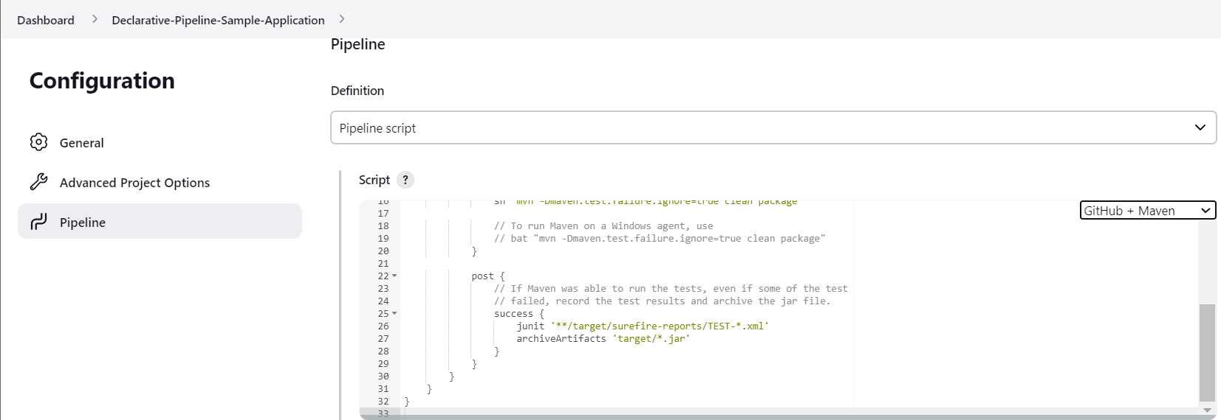
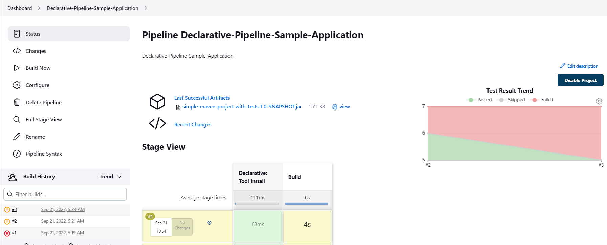
7.2 Declarative Pipelines Jobs.
Declarative Pipelines : Build Sample Application (Pipeline Scripts)

Slide 31
8. Jenkins master-slave distributed build concepts.
What is a distributed build?
Distributed building is an extension of parallel building that allows the use of multiple machines to perform the steps of a build.
Why are distributed builds required?
Below are a few of the main reasons that justify the need for distributed builds in a CI system:
Fault Tolerance: We need to preserve information in the event of machine or data center failures or an entire wipeout of regions.
Reduce latency: We need to reduce customer response time, which may spread throughout the world.
Availability: If a machine breaks down or becomes slow, we need another machine nearby to serve the requests to avoid request failure. Monolithic system's availability is limited only to the piece of hardware it runs on. In the case of distributed systems, there are several machines, and availability is much improved.
Durability: Distributed storage systems allow a great deal of flexibility around cost, durability, time-to-recovery, etc., by making multiple copies of a piece of data. They are also highly tolerant of correlated failures and can avoid correlation outright.
Scalability: Distributed systems can offer better scalability. Since we distribute the system over many machines, we have a lot of flexibility to scale up the system.
Efficiency: Needless to say, distributed systems are more efficient. Though workloads are seldom constant and we need to work on an hourly basis, every day, or even every minute, distributed systems can offer us automated scaling tools that provide better efficiency.

Slide 32
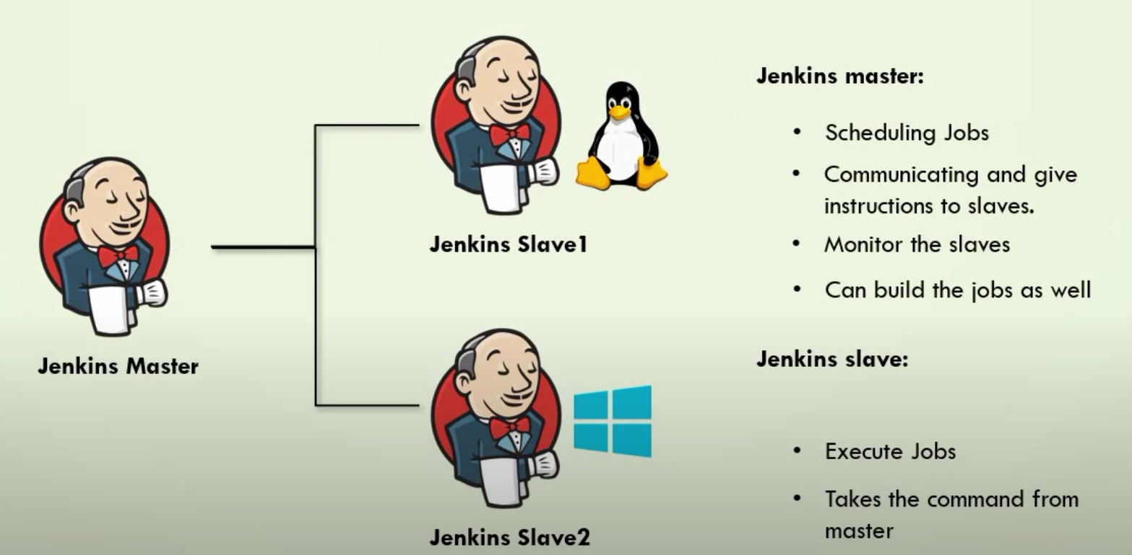
8. Jenkins master-slave distributed build concepts.
Jenkins uses a Master-Slave architecture to manage distributed builds. The Master and the slaves communicate through TCP/IP protocol.
Jenkins Master
The Jenkins Master is the main Jenkins server and performs the following functions:
It schedules the build jobs.
Additionally, it dispatches the builds to the various slaves for the actual execution.
It continuously monitors the slaves.
Also, records the build results and presents them.
If required, Master can also execute build jobs directly.
Jenkins Slave
A Slave runs on a remote machine and is a Java executable. A slave performs the following functions:
It listens to requests from the Jenkins Master.
Slaves can run on a variety of operating systems.
Additionally, it executes build jobs that the Master dispatches.
Apart from the fact that Jenkins always picks up the next available slave to execute the build job, we can always configure the project to always run on a particular type of slave machine.

Slide 33
8. Jenkins master-slave distributed build concepts.
Master & Slave machines Configurations - Demo
Steps to follow
Jenkins server and Slave node.
Install java on Slave node.
Configure slave node under manage nodes of Jenkins Master.
Download agent.jar onto slave node.
Run java command to connect with Jenkins Server.

Slide 34

9. Security Matrix options in Jenkins.
How to Setup User Security on Jenkins with Project Matrix Authorization
Step 1.Project-based Matrix Authorization Setup
a.Manage Jenkins
To setup the project-baesd matrix authorization, click on the “Manage Jenkins” link on the left side menu items. Which will show you the following screen.

Slide 35

9. Security Matrix options in Jenkins.
b. Configure Global Security
From the Manage Jenkins, click on “Configure Global Security Option”, which will display the following security configuration screen.
Under the “Authorization” section, by default, “Logged-in users can do anything” option is selected.
As the name suggests, anybody who has an account in Jenkins can login and do anything they want, as they’ll have full control. In this mode, anonymous user gets to only read everything. This option is good if you are setting up a public-facing Jenkins.
But if you are setting up Jenkins for your organization use, where you want developers to build and deploy applications on your servers, you may not prefer this option.
So, to setup project-based security where you can assign the privileges to the individual user, click on “Project-based Matrix Authorization Strategy”.

Slide 36
9. Security Matrix options in Jenkins.
Access Control
Access Control is the primary mechanism for securing a Jenkins environment against unauthorized usage. Two facets of configuration are necessary for configuring Access Control in Jenkins:
A Security Realm which informs the Jenkins environment how and where to pull user (or identity) information from. Also commonly known as "authentication.“
2.Authorization configuration which informs the Jenkins environment as to which users and/or groups can access which aspects of Jenkins, and to what extent.
Using both the Security Realm and Authorization configurations it is possible to configure very relaxed or very rigid authentication and authorization schemes in Jenkins.
Additionally, some plugins such as the Role-based Authorization Strategy plugin can extend the Access Control capabilities of Jenkins to support even more nuanced authentication and authorization schemes.

Slide 37
9. Security Matrix options in Jenkins.
Security Realm
By default Jenkins includes support for a few different Security Realms:
Delegate to servlet container
For delegating authentication a servlet container running the Jenkins controller, such as Jetty. If using this option, please consult the servlet container’s authentication documentation.
Jenkins’ own user database
Use Jenkins’s own built-in user data store for authentication instead of delegating to an external system. This is enabled by default with new Jenkins 2.0 or later installations and is suitable for smaller environments.
LDAP
Delegate all authentication to a configured LDAP server, including both users and groups. This option is more common for larger installations in organizations which already have configured an external identity provider such as LDAP. This also supports Active Directory installations.

Slide 38
9. Security Matrix options in Jenkins.
Authorization
The Security Realm, or authentication, indicates who can access the Jenkins environment. The other piece of the puzzle is Authorization, which indicates what they can access in the Jenkins environment. By default Jenkins supports a few different Authorization options:
Anyone can do anything
Everyone gets full control of Jenkins, including anonymous users who haven’t logged in. Do not use this setting for anything other than local test Jenkins controllers.
Legacy mode
Behaves exactly the same as Jenkins <1.164. Namely, if a user has the "admin" role, they will be granted full control over the system, and otherwise (including anonymous users) will only have the read access. Do not use this setting for anything other than local test Jenkins controllers.
Logged in users can do anything
In this mode, every logged-in user gets full control of Jenkins. Depending on an advanced option, anonymous users get read access to Jenkins, or no access at all. This mode is useful to force users to log in before taking actions, so that there is an audit trail of users' actions.

Slide 39

9. Security Matrix options in Jenkins.
c. Matrix-based security
Matrix-based security is one of the authorization strategies available for securing Jenkins. It allows you to grant specific permissions to users and groups. The available permissions are listed below with their descriptions, and are also available by hovering over the permission heading in the Jenkins UI.

Slide 40

9. Security Matrix options in Jenkins.
d. Project-based Matrix Authorization Strategy
Project-based Matrix authorization strategy is an extension to “Matrix-based security”, where you can setup ACL to individual projects. This means that you can allow a specific user to access only certain projects.
The moment you click on the “Project-based Matrix Authorization Strategy” radio-button, it will display the table , where you can add users and assign them individual privileges by clicking on the check-box.

Slide 41
THANK YOU

